Slide 1
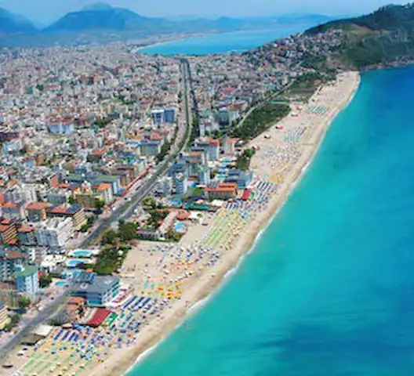
Comparison of Beaches
ANALYSIS AND CLUSTERING OF BEACHES USİNG DATA SCIENCE TOOLS AND TECHNİQUES
GOKHAN EKICI
IBM DATA SCIENCE CAPSTONE 06/07/2020

Slide 2
Definition of The Problem
When you move to a new country or when you would like to visit a new country for sun, sea, and beaches, you have many websites that provide information about your options. Just like moving to a new neighborhood you want to learn the details, but some details are confusing and some of the content you must read biased. When you search for “best beaches in US” on Google for example, you receive over 400.000 results. And although you know Google sorts them in a relevant order, when you check those results you are confused, you see that the top lists do not overlap, and you might get confused.
On the other hand, when you are deciding to buy a tool, a furniture a holiday package you mostly rely on people with similar tastes like you. But if you are new to a country, if you will visit it for the first time then the chances that you will find someone to understand what you want and respond to it with a good recommendation gets lower.
Today as we have so much information
why would not we make my own decision,
based on available data out there?

Slide 3
Solution Proposal
A similarity analysis, a clustering algorithm might help us all choose places to see given the similarity between the places we like our favorite beach and the surrounding venues and neighborhood.
This could be a self-service model which could lead to an affiliate model for tourism agencies or could be directly used by tourism agencies.
A choice of a beach holiday has 3 main elements.
The beach, its rating and the neighborhood restaurants and cafes and bars etc.
The climate
The accommodation choices
During this analysis I focused on the first 2 as most beautiful beaches already have many accommodation choices and there is plenty of reliable price and feature data on the booking sites.
A model that will take your favorite beach as input, and provide a clustering
in a different country you would like to visit for beach vacation might work for you.

Slide 4
Data Used for Analysis
I used 3 main data sets available online, the ones available for free for the sake of this Capstone Project.
A list of best beaches in US derived from USNEWS Travel site, Tripadvisor and Foursquare, Tripadvisor, Google ratings for these beaches.
Climate data was derived from visualcrossing.com. It required a membership.
Foursquare Venue Data available through Foursquare API.
Finding free, reliable and unbiased data is hard.
But when it is found it is even harder to analyze it ourselves.
Why do not we trust Machine Learning do that for us?

Slide 5
Methodology
The beach-based rating, important climate information (temperature, humidity etc.), venues and categories of venues in the neighborhood were normalized with min-max normalization method for effective clustering.
Climate data was normalized first with «Normal conditions».
In order to understand the similarities between the shortlist of beaches I have chosen, and our favorite beach (beaches) I added to the list, I used clustering methods K-Means and DBSCAN.
K-Means without the climate data,
K-Means with climate data to see the differences when we run the clustering with climate data.
DBSCAN and see if it has to offer any insight.
K-Means, although it has model developer’s bias has given some significant results whereas DBSCAN was unable to cluster 8 of 10 beaches.
A model based on K-Means Clustering helps us find
the most suitable beaches to our taste!

Slide 6
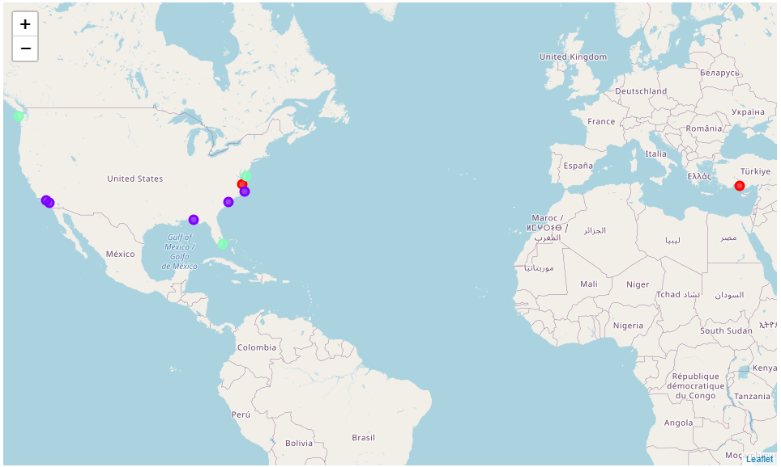
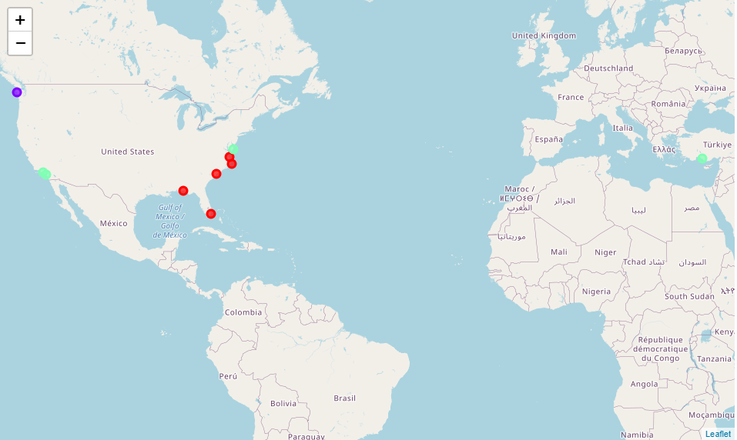
Results
K-Means without climate data proposed that the most similar beach to Alanya, Turkey was Virginia Beach in Virginia US.
K-Means with climate data proposed that the most similar beaches to Alanya, Turkey were in California and Ocean City, MD.
Venues near a beach and the climate are very important parameters to be considered while choosing a beach vacation destination!

Slide 7
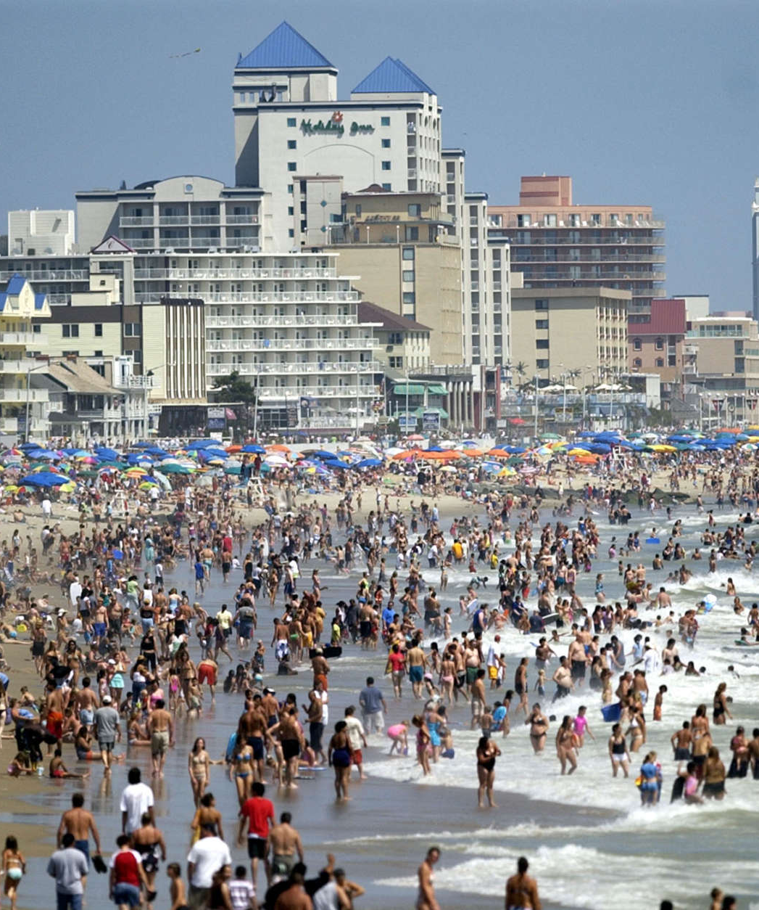
Conclusion
The model works well to compare beaches and cluster them so that you can choose where you would like to have your next beach vacation in a new country, in a new part of your country etc. The important issue is you should be very much aware of the biased and commercial data out there on the web.
I feel better about my next vacation search process already. I hope this might help others in the future as well.

